Slide 1



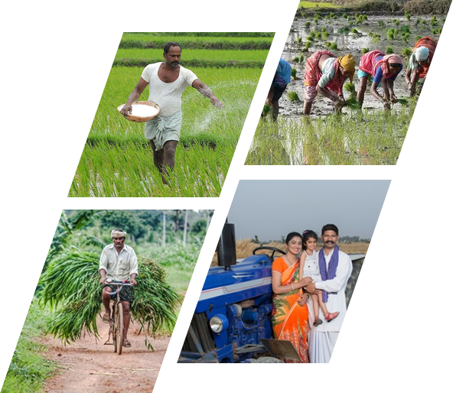




Farmer’s Diary
Developer Team
Md. Jobaer Hossain[19202203001][Leader]
Md. Galib Hossain[19202203001]
Shariful Islam Shanto[19202203104]
Md. Alamin[19202203109]
Supervised By
Sweety Lima
Department Of CSE
Bangladesh University Of Business and Technology
Bangladesh University of Business and Technology
Dhaka, Bangladesh
10 March, 2023
www.bubt.edu.bd
Team: 01

Slide 2



Content Outline
Motivation and Background
Objective
Requirement Study
Unified Modeling Language
Design and Data Component Structure
Necessary Tools
Conclusion

Slide 3







Why Farmer’s Diary
Data Security
Real-time Monitoring
Price Monitoring
Latest Update
Life time data storage

Slide 4
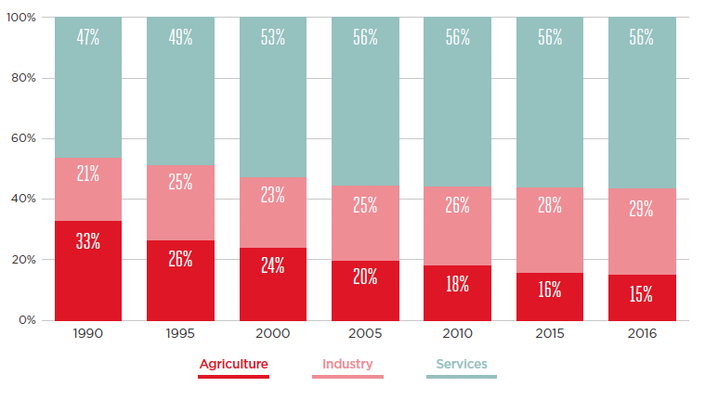
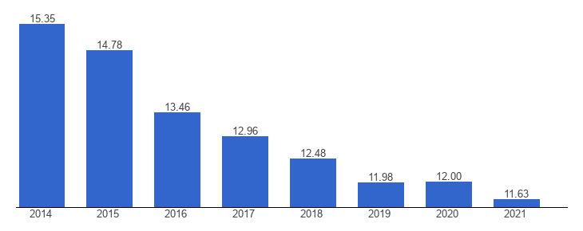
Why Farmer’s Diary
theglobaleconomy
Rahman, Md. Sadekur & Haque, Md & Afrad, Md Safiul Islam. (2020). Utility of Mobile Phone Usage in Agricultural Information Dissemination in Bangladesh. 3. 154-170. 10.36349/EASJALS.2020.v03i06.020.

Slide 5
Requirement Study
Data Archive
Different User’s Profile
Products Categories
Analytical Chart
Set Reminder
Offline and Online Payment Getway

Slide 6
Objectives
Farmer’s Data Storage
Seller-Mediator’s Data Storage
Buyer's Data Storage
Individual product Details
Make reminder

Slide 7







Problem and Solutions
Sell Product on Right Price
Immoral Reserved
Archive
Face Recognition
Finger print
User and PWS

Slide 8

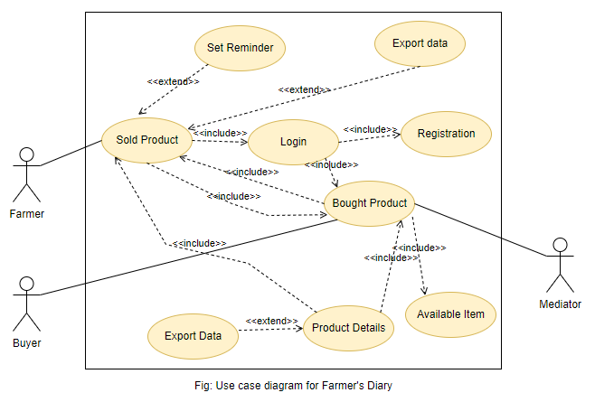


USE-CSE DIAGRAM LANGUAGE
Seller
OUR STACKHOLDER
Buyer
Author

Slide 9
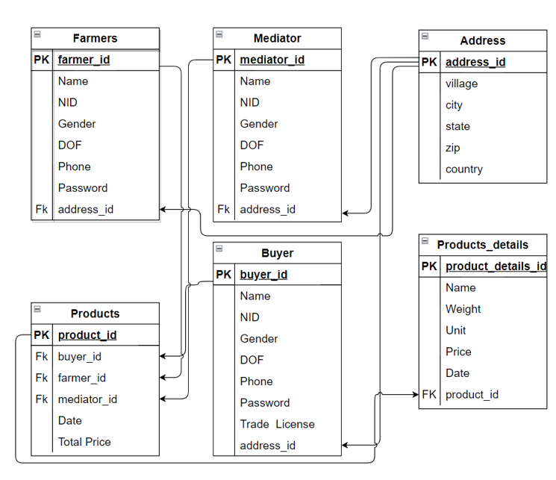
Schema Diagram For Propose System

Slide 10
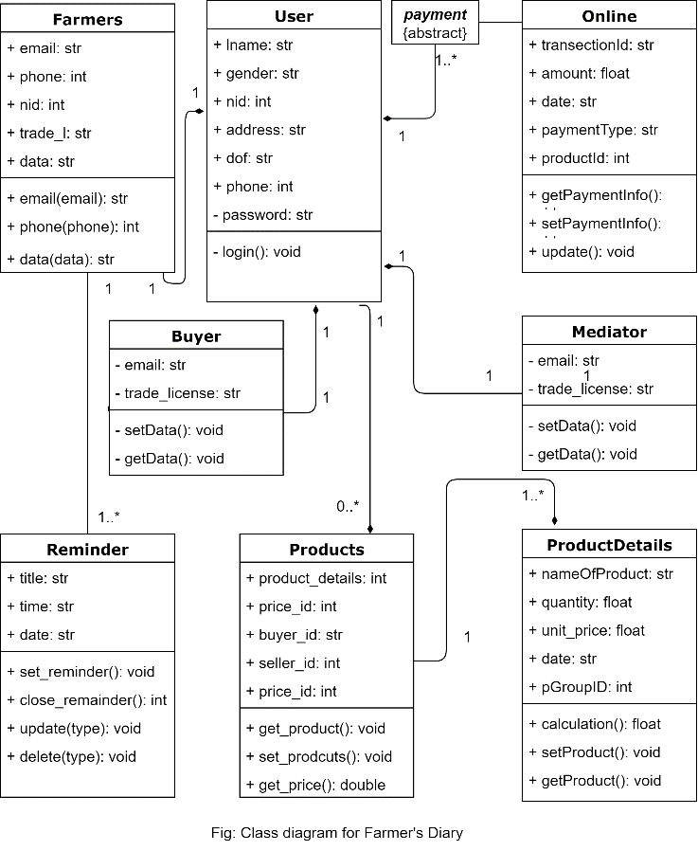
Class Diagram

Slide 11
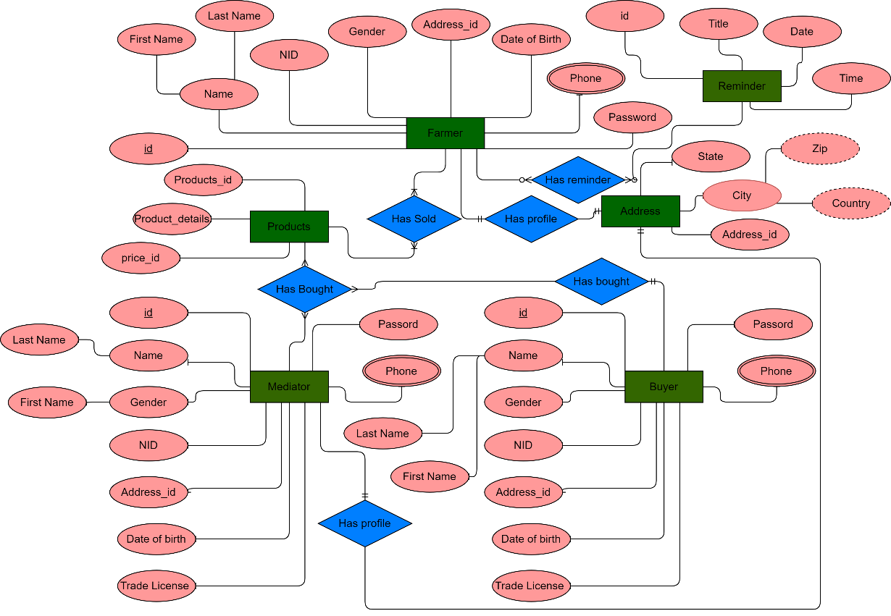
Design and Data Component Structure

Slide 12
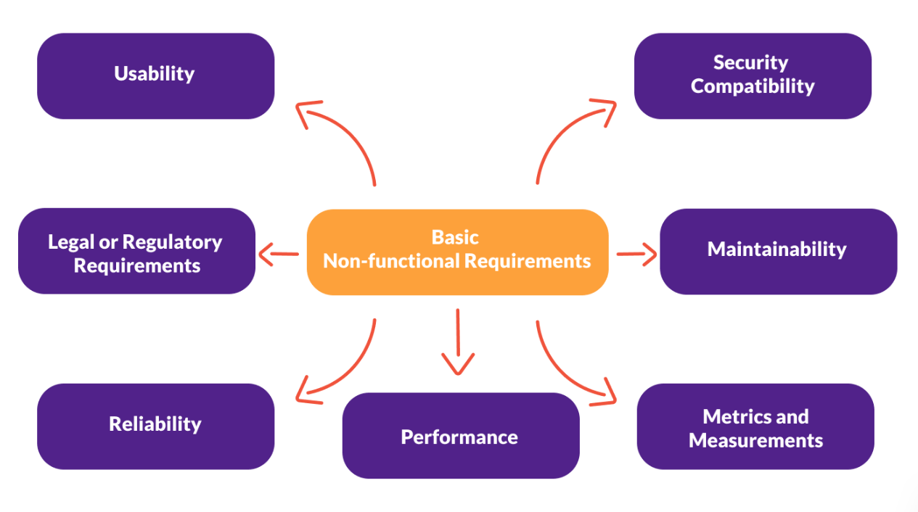
Non-functional area

Slide 13

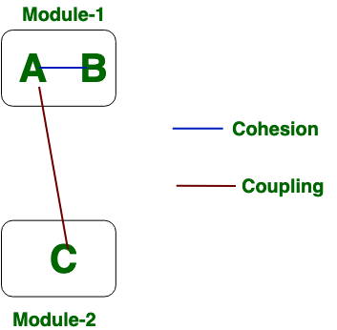
Dependency

Slide 14
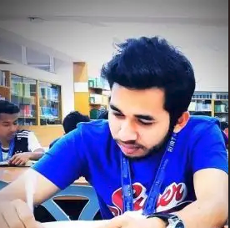
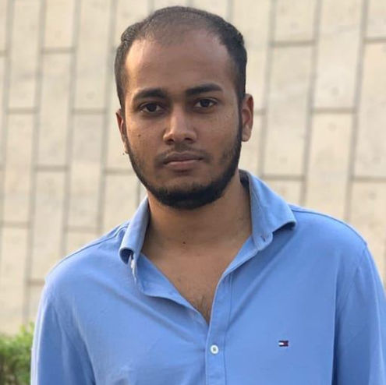
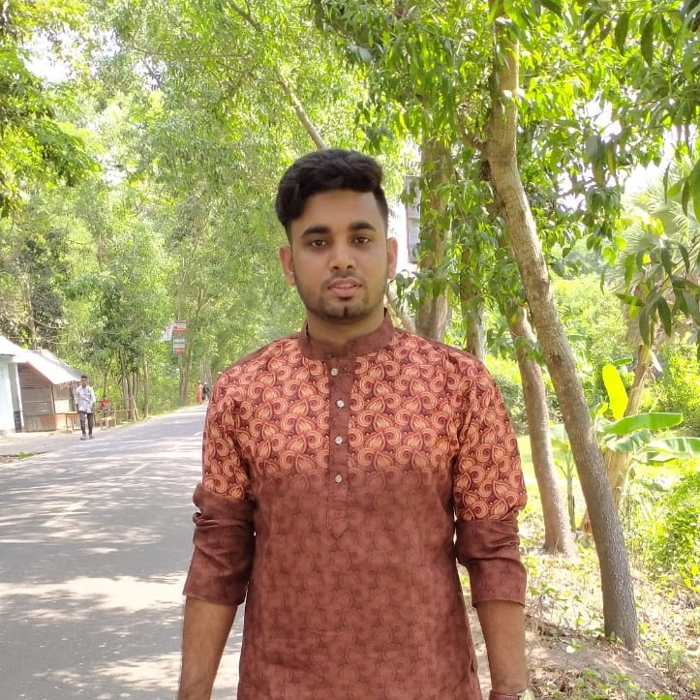
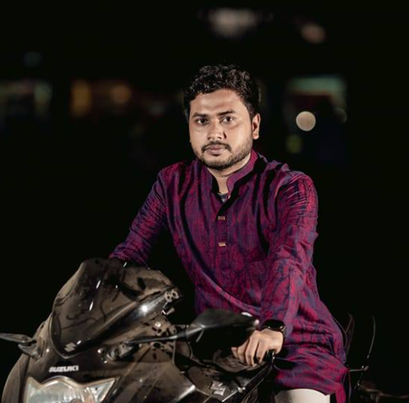
OUR TEAM
Md. Jobaer Hossain
Diploma in Lab Medicine, B.Sc(CSE)
Problem solver and Full stack Web Developer
Bangladesh University of Business and Technology
Md Galib Hossain
Diploma in Computer Science and Engineering B.Sc(CSE)
Problem solver and Full stack Web Developer
Bangladesh University of Business and Technology
Shariful Islam Shanto
Diploma in Computer Science and Engineering, B.Sc(CSE)
Bangladesh University of Business and Technology
Md. Alamin
Diploma in Computer Science and Engineering, B.Sc(CSE)
Bangladesh University of Business and Technology

Slide 15
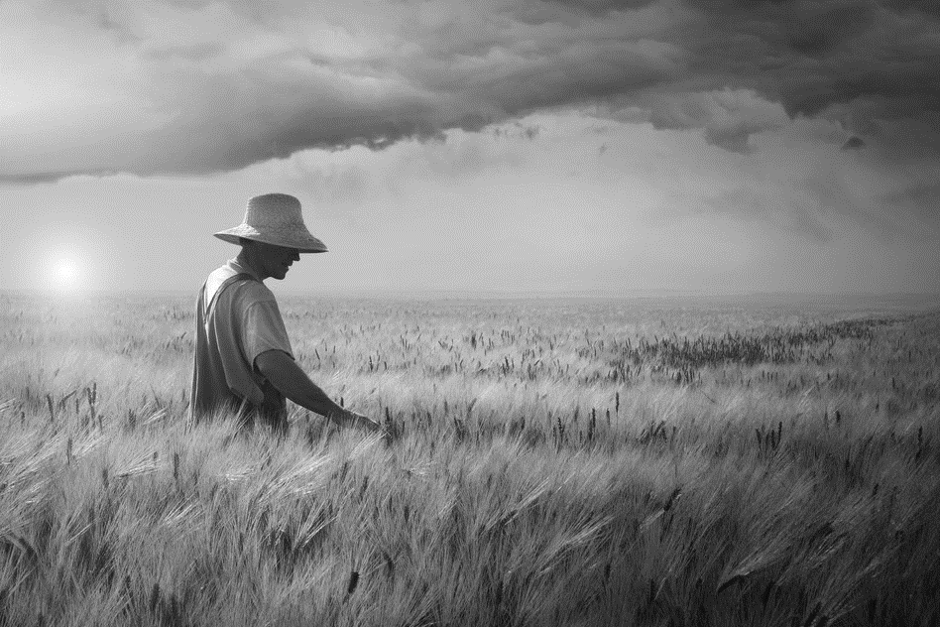
May the sunrise of new dreams of the farmer every day. “Investment in agriculture is the best weapon against hunger and poverty, and they have made life better for billions of people.”
Conclusion and Future work

Slide 16
If you have any questions, please feel free to ask

Slide 17
Thank you

